Slide 1
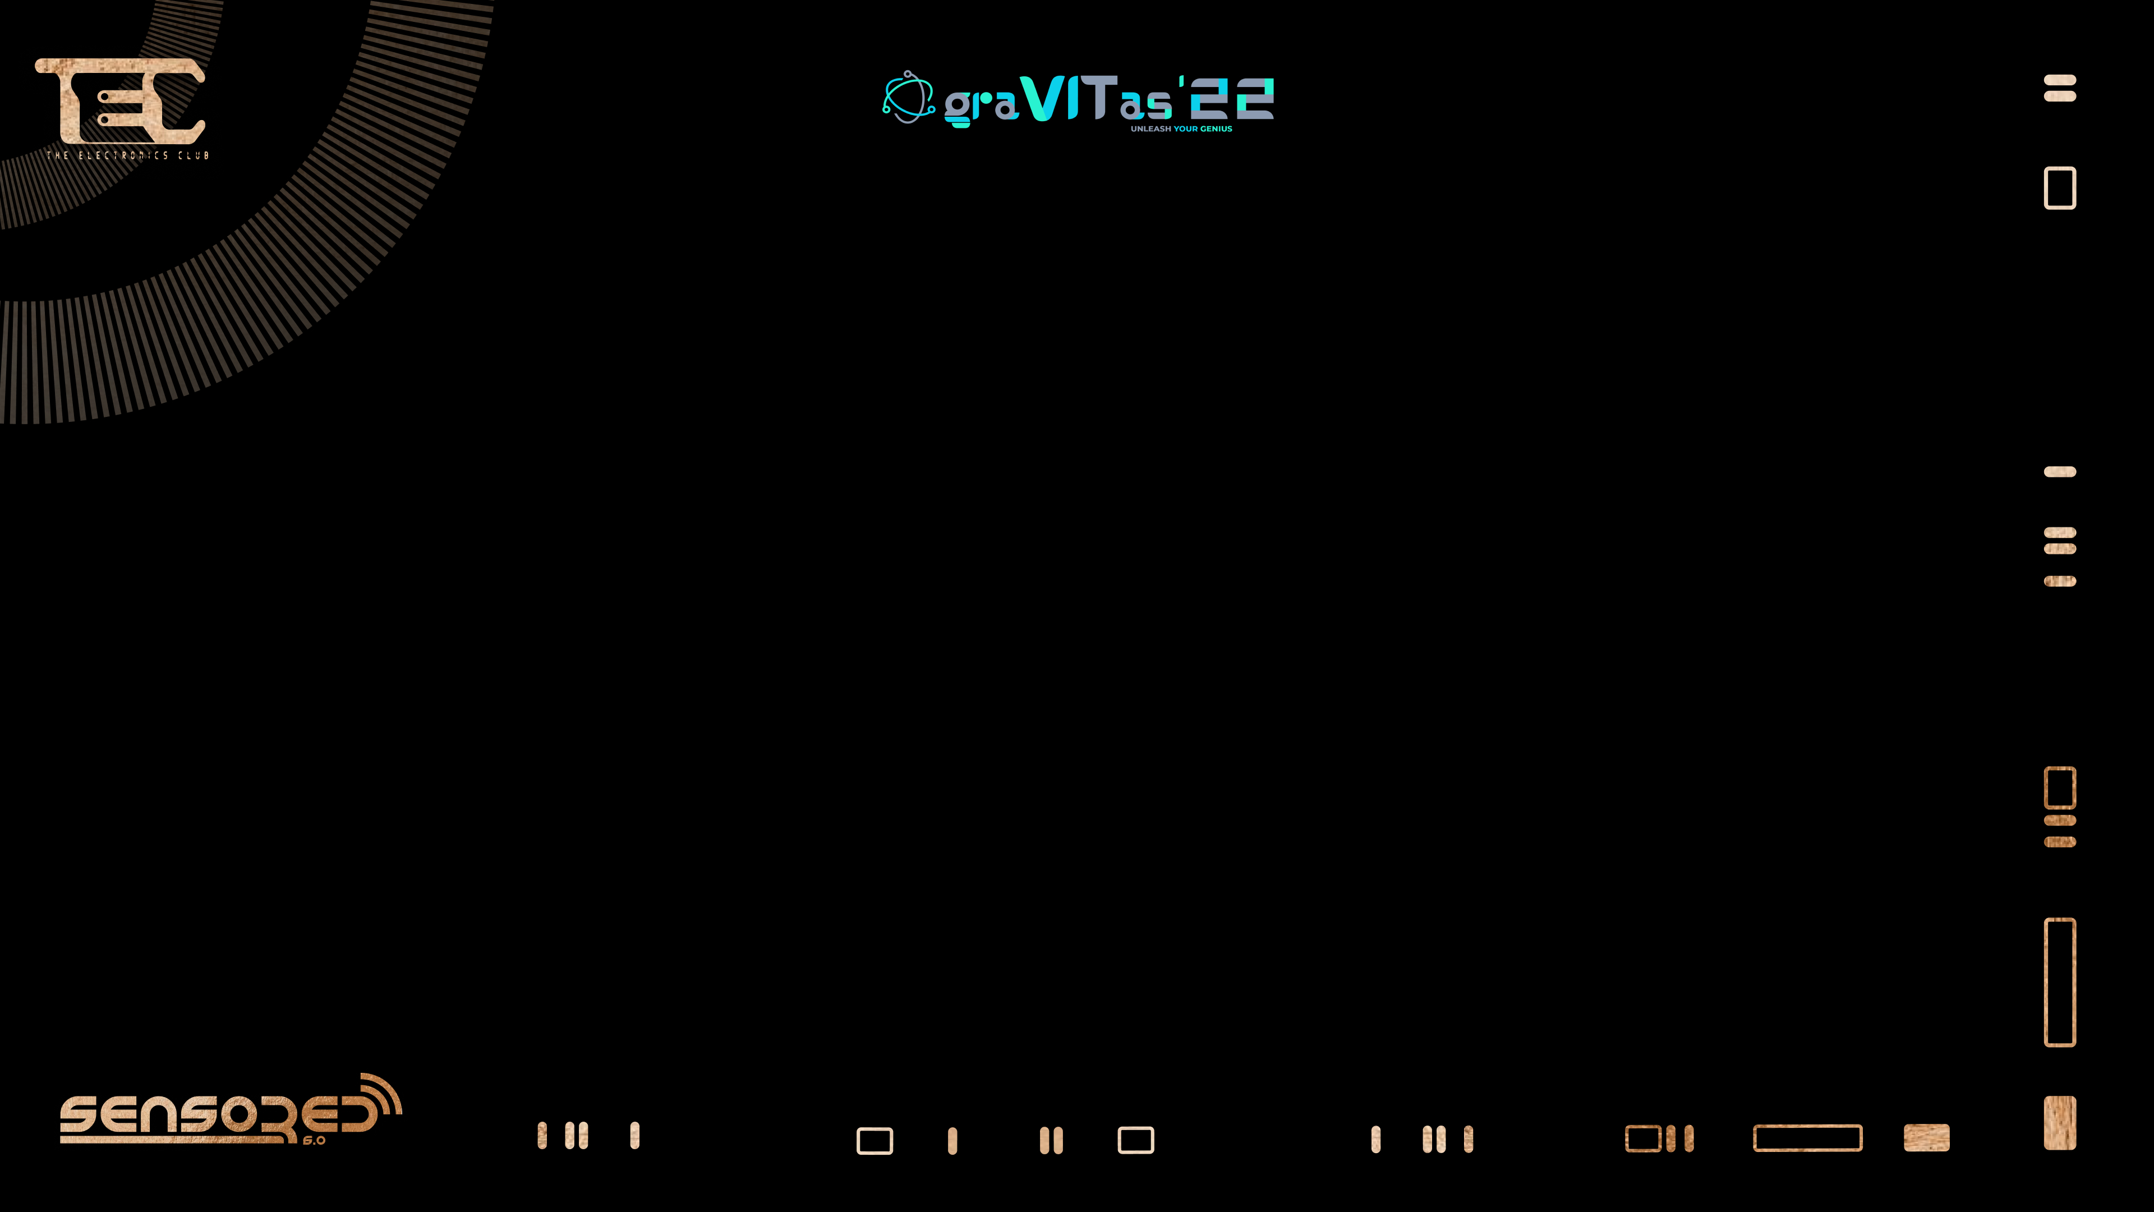


Slide 2
ADXL345
Accelerometer for all​​

Slide 3
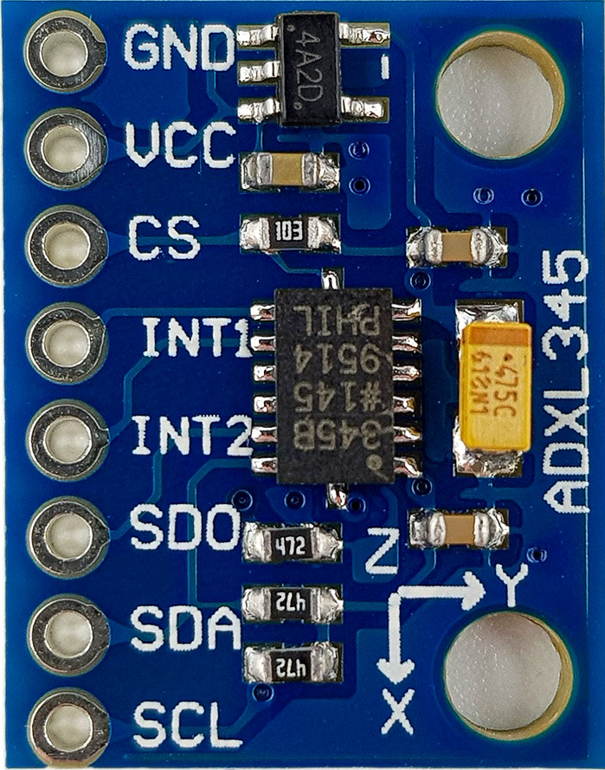
What is an accelerometer?
It is an electromechanical device.
Measures proper acceleration along all 3 axes in the
3D coordinate plane.
Uses the principle of damped mass system.

Slide 4
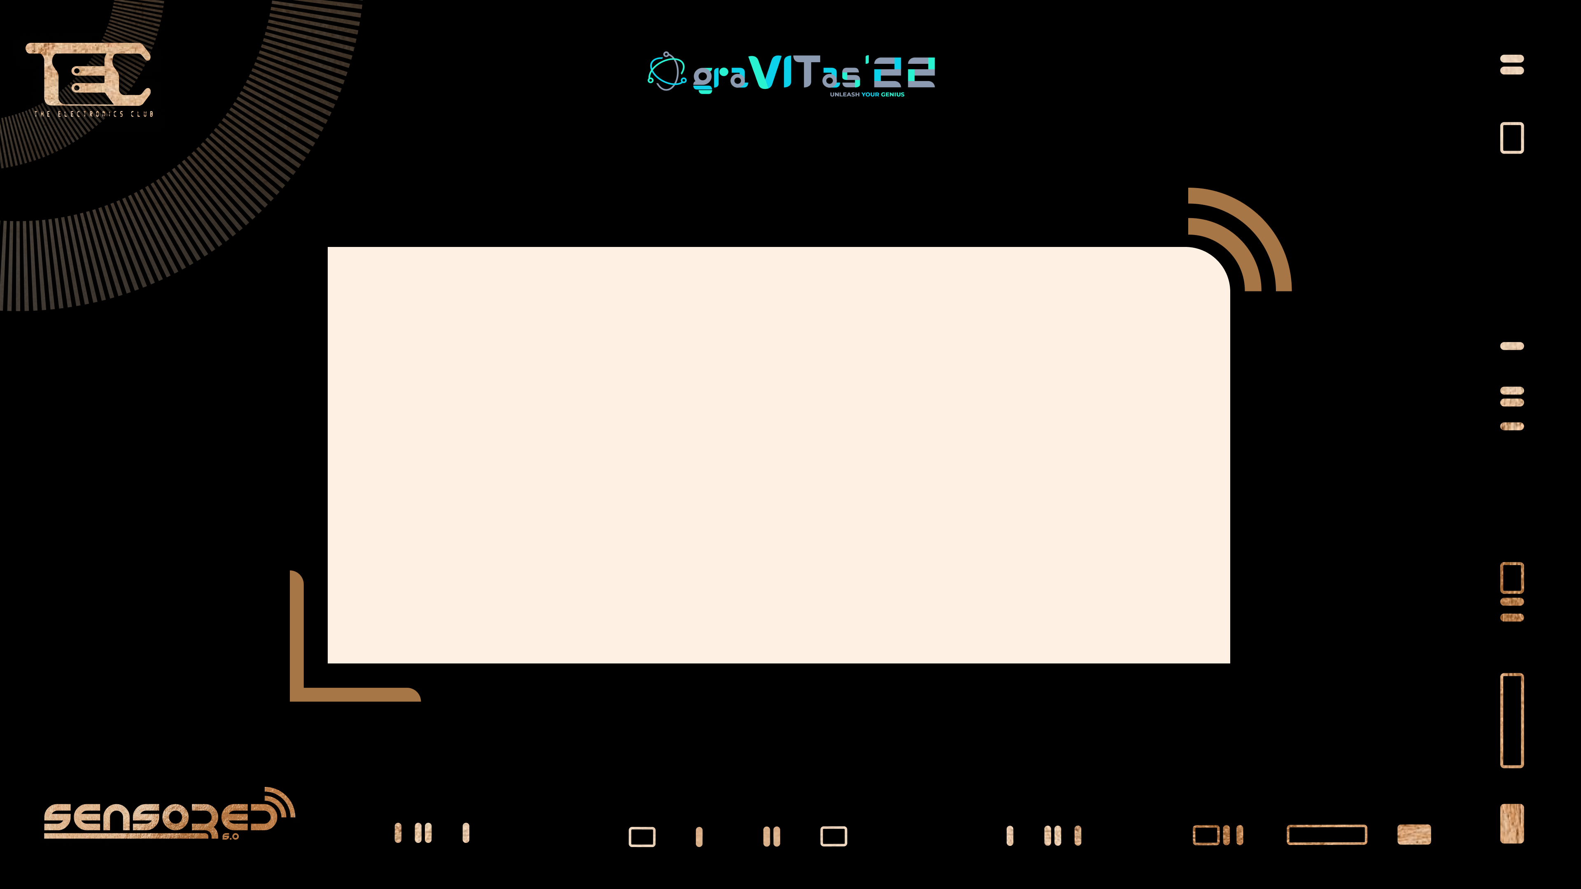
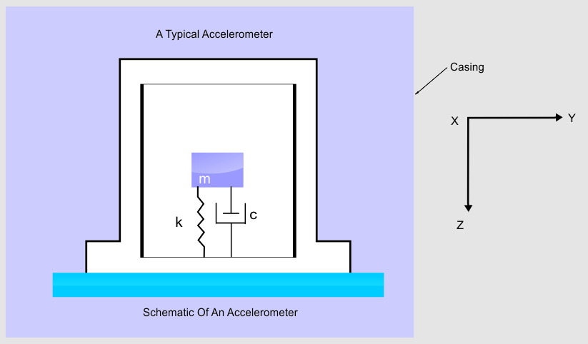

Slide 5
Types of accelerometers
Piezoelectric
Piezoresistive
MEMS

Slide 6
PIEZOELECTRIC SENSOR
What is a piezoelectric material?
A material that has the ability to generate electric charge in itself on applying mechanical stress.

Slide 7
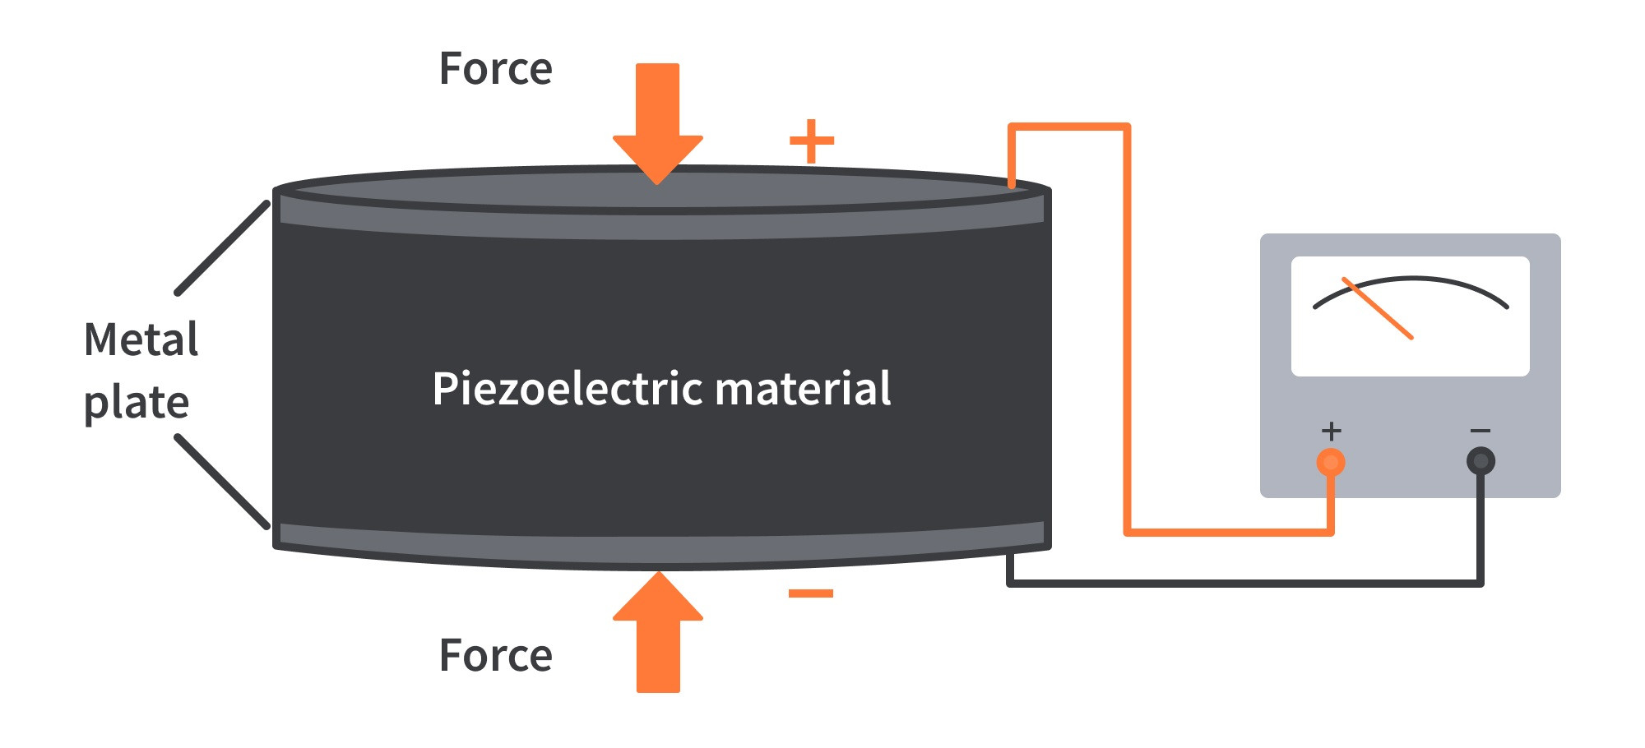

Slide 8
PIEZORESISTIVE SENSOR
What is piezoresistive effect?
Change in electric resistivity of semiconductor or metal due to the application of mechanical strain.

Slide 9

Many of you right now are like :
What exactly is a MEMS?

Slide 10
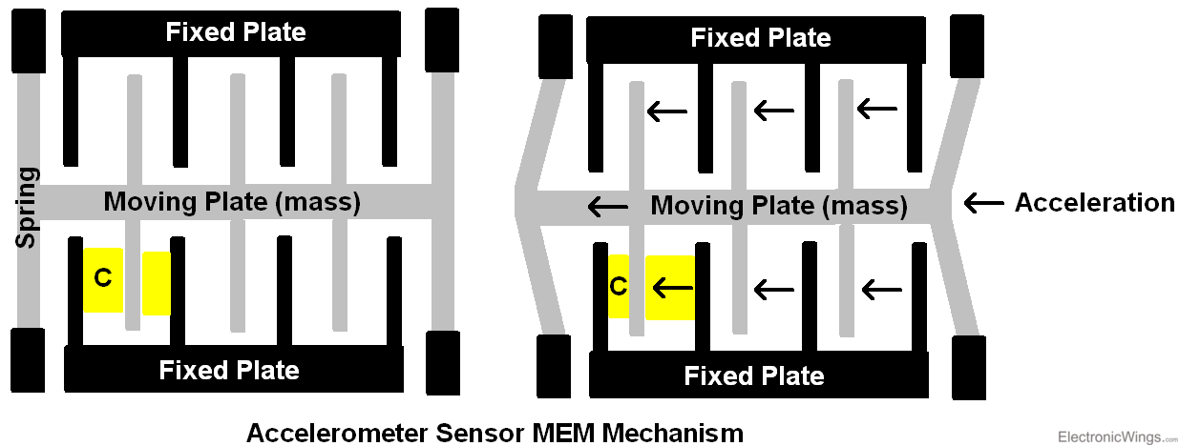
MEMS
Micro-Electro-Mechanical Systems, or MEMS, is a technology that in its most general form can be defined as miniaturized mechanical and electro-mechanical elements (i.e., devices and structures) that are made using the techniques of microfabrication.

Slide 11
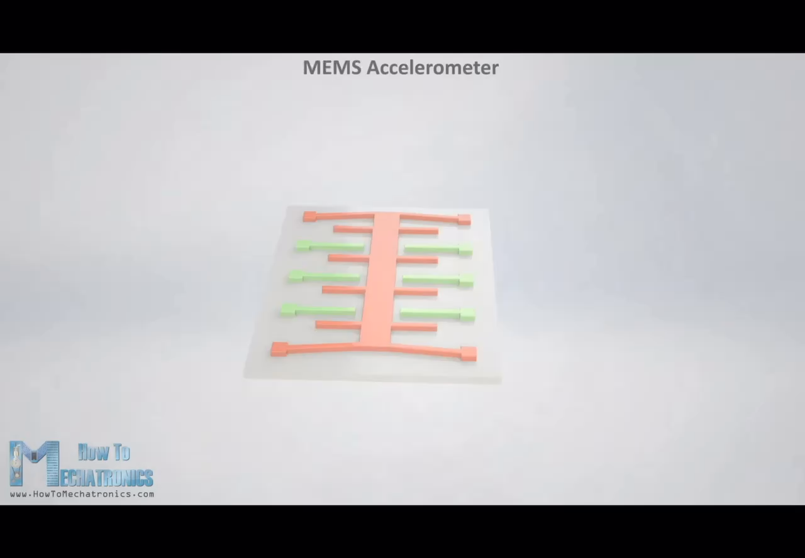

Slide 12
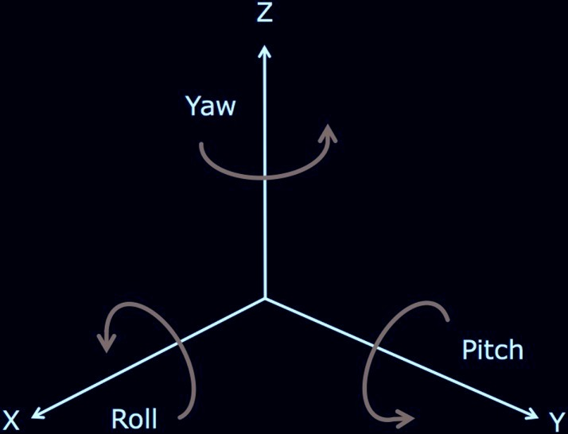
3 axis accelerometer
A 3-axis accelerometer is a device that is designed to measure acceleration along three axes in space — the forward and back X-axis, the left and right Y-axis, and the up and down Z-axis.
The angle around each axis are respectively roll, pitch and yaw.

Slide 13

I DON’T BELIEVE YOU,
SHOW ME A VIDEO

Slide 14
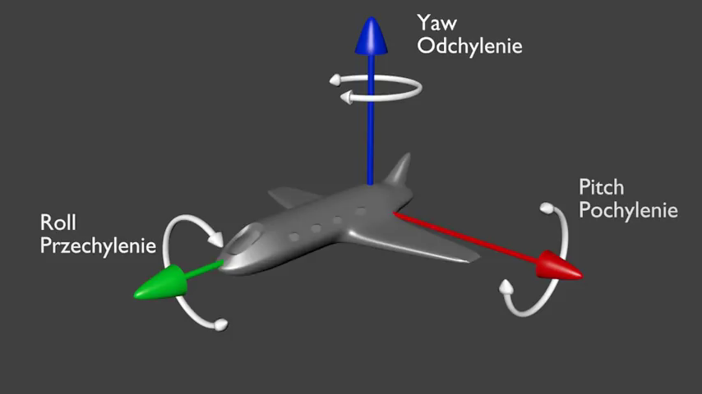
A clear idea of these angles
Row pitch and yaw are rotational forces or moments along x,y, and z axes.
Roll happens in response to cornering centrifugal forces
Pitch happens in response to acceleration or deceleration
Yaw happens in response to cornering or side wind ; sharper the turn greater the yaw

Slide 15
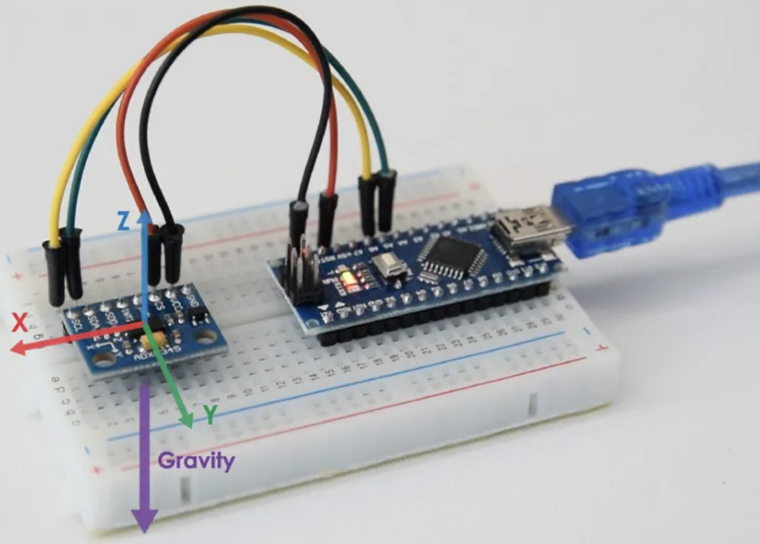
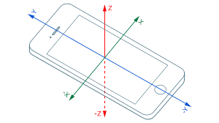
Let’s welcome our hero of the day…… ADXL345

Slide 16
Ground
Common collector voltage
Chip select(Slave select)
Interrupt 1
Interrupt 2
Serial Data Out
Serial Data Line
Serial Clock Line
Voltage regulator IC
Level Shifter IC
ADXL IC

Slide 17
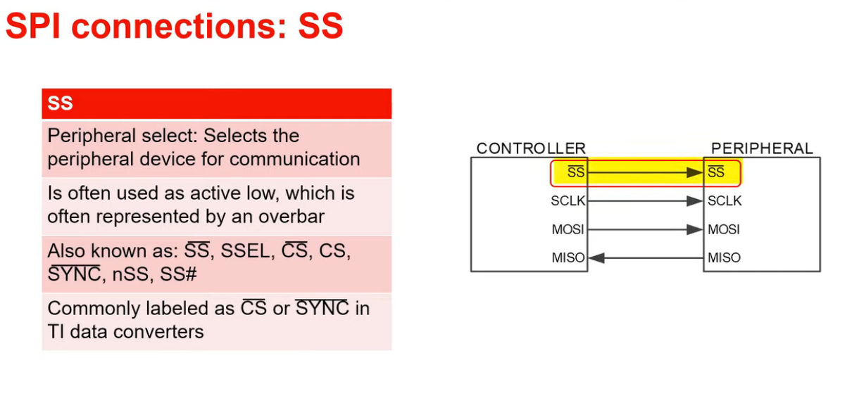

Slide 18
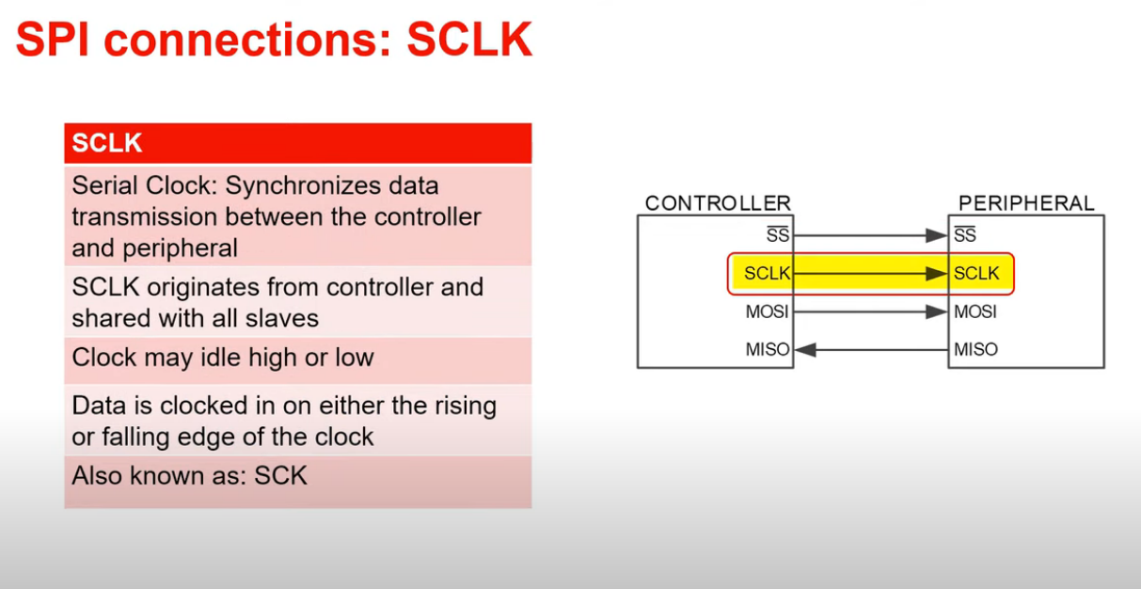

Slide 19
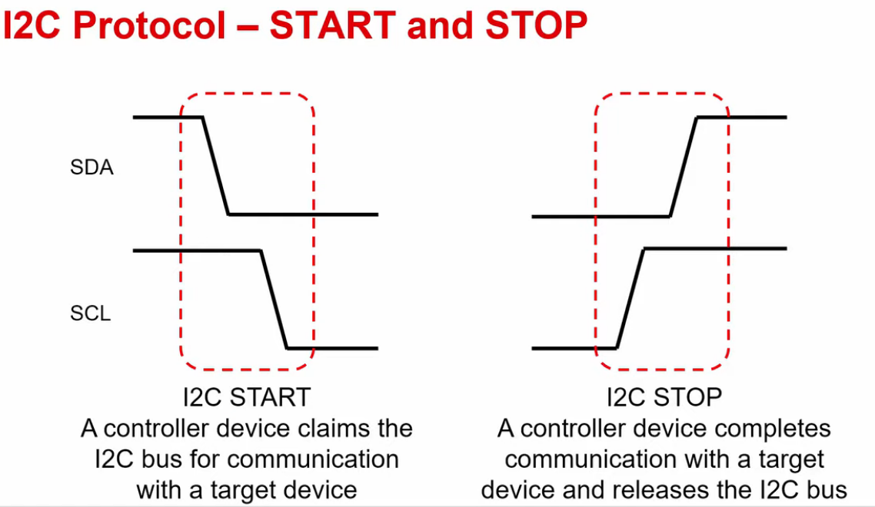

Slide 20


Slide 21
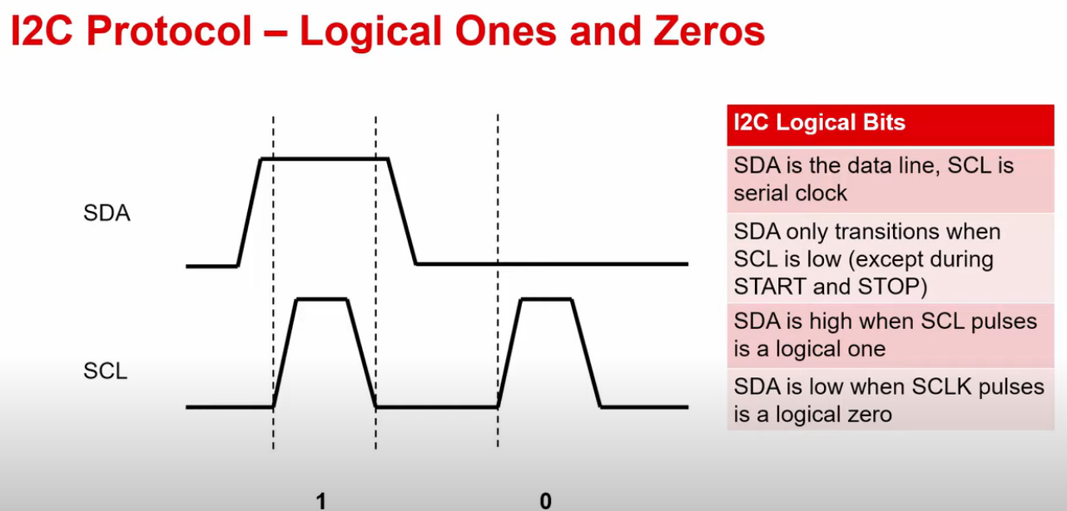

Slide 22
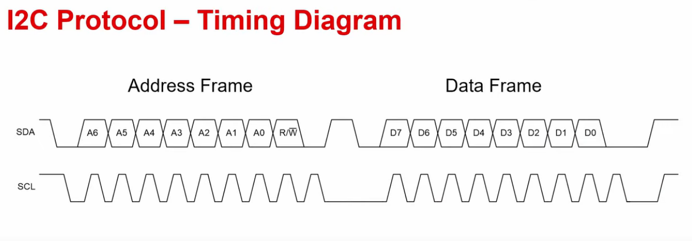

Slide 23

Now let’s code!

Slide 24
Including the library of Wire.h and why it’s used
#include <Wire.h>
#include <Adafruit_Sensor.h>
#include <Adafruit_ADXL345_U.h>
Adafruit_ADXL345_Unified accel = Adafruit_ADXL345_Unified();
float X_out, Y_out, Z_out; // Outputs
float roll, pitch, rollF, pitchF, yaw, yawF = 0;
int ADXL345 = 0x53;

Slide 25
void setup(void)
{
Serial.begin(9600);
pinMode(2, OUTPUT);
pinMode(3, OUTPUT);
pinMode(4, OUTPUT);
Wire.begin(); // Initiate the Wire library
// Set ADXL345 in measuring mode

Slide 26
Wire.beginTransmission(ADXL345); // Start communicating with the device
Wire.write(0x2D); // Access/ talk to POWER_CTL Register - 0x2D
// Enable measurement
Wire.write(8); // Bit D3 High for measuring enable (8dec -> 0000 1000 binary)
Wire.endTransmission();
delay(10);

Slide 27
//Off-set Calibration
//X-axis
Wire.beginTransmission(ADXL345);
Wire.write(0x1E);
Wire.write(1);
Wire.endTransmission();
delay(10);
How to calibrate the offset of readings

Slide 28
//Y-axis
Wire.beginTransmission(ADXL345);
Wire.write(0x1F);
Wire.write(-2);
Wire.endTransmission();
delay(10);
How to calibrate the offset of readings

Slide 29
//Z-axis
Wire.beginTransmission(ADXL345);
Wire.write(0x20);
Wire.write(-9);
Wire.endTransmission();
delay(10);
How to calibrate the offset of readings

Slide 30


Slide 31
Now back to Code
void loop(void)
{
sensors_event_t event;
accel.getEvent(&event);
X_out = event.acceleration.x;
Y_out = event.acceleration.y;
Z_out = event.acceleration.z;
Now we will read the data from the accelerometer and print it on the serial monitor.

Slide 32
Now back to Code
Serial.print("X: "); Serial.print(event.acceleration.x); Serial.print(" ");
Serial.print("Y: "); Serial.print(event.acceleration.y); Serial.print(" ");
Serial.print("Z: "); Serial.print(event.acceleration.z); Serial.print(" ");
Serial.println("m/s^2 ");
delay(2000);
Now we will read the data from the accelerometer and print it on the serial monitor.

Slide 33
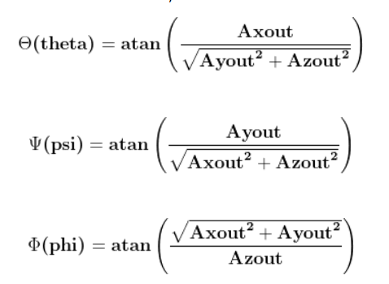
This is how to calculate the values theoretically and below the code to calculate it by coding.
roll = atan(Y_out / sqrt(pow(X_out, 2) + pow(Z_out, 2))) * 180 / PI;
pitch = atan(-1 * X_out / sqrt(pow(Y_out, 2) + pow(Z_out, 2))) * 180 / PI;
yaw = atan(sqrt(pow(X_out, 2) + pow(Y_out, 2)) / Z_out) * 180 / PI;

Slide 34
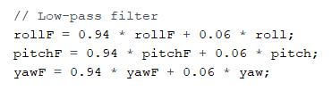
What are low-pass filter used for?
Low pass filters are used to filter noise from a circuit. 'Noise' is a high frequency signal. When passed through a low pass filter most of the noise is removed and a clear sound is produced. high-cut or treble cut filters.

Slide 35
Serial.print(rollF);
Serial.print("/");
Serial.println(pitchF);
Serial.print("/");
Serial.println(yawF);
float x = event.acceleration.x;
float y = event.acceleration.y;
float z = event.acceleration.z;
if ( x >= 8.5) {
digitalWrite(3, LOW);
digitalWrite(4, LOW);
digitalWrite(2, HIGH);
}
if (y >= 8.5) {
digitalWrite(2, LOW);
digitalWrite(4, LOW);
digitalWrite(3, HIGH);
}
if (z >= 8.5) {
digitalWrite(2, LOW);
digitalWrite(3, LOW);
digitalWrite(4, HIGH);
}
}
How to see the directions

Slide 36

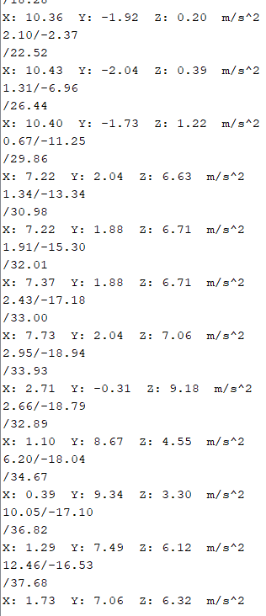

Slide 37
Pin Connections
SDA – A4
SCL – A5
VCC – 5V
GND – GND
LED 1 - +ve end D2 –ve end GND
LED 2 - +ve end D3 –ve end GND
LED 3 - +ve end D4 –ve end GND

Slide 38


Slide 39
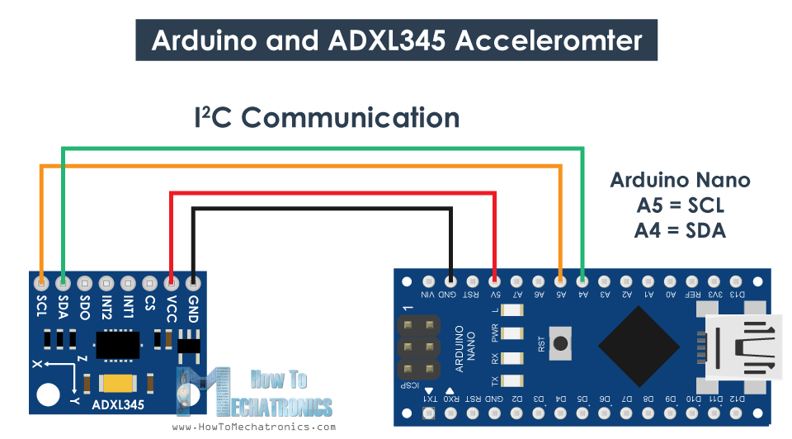




Slide 40
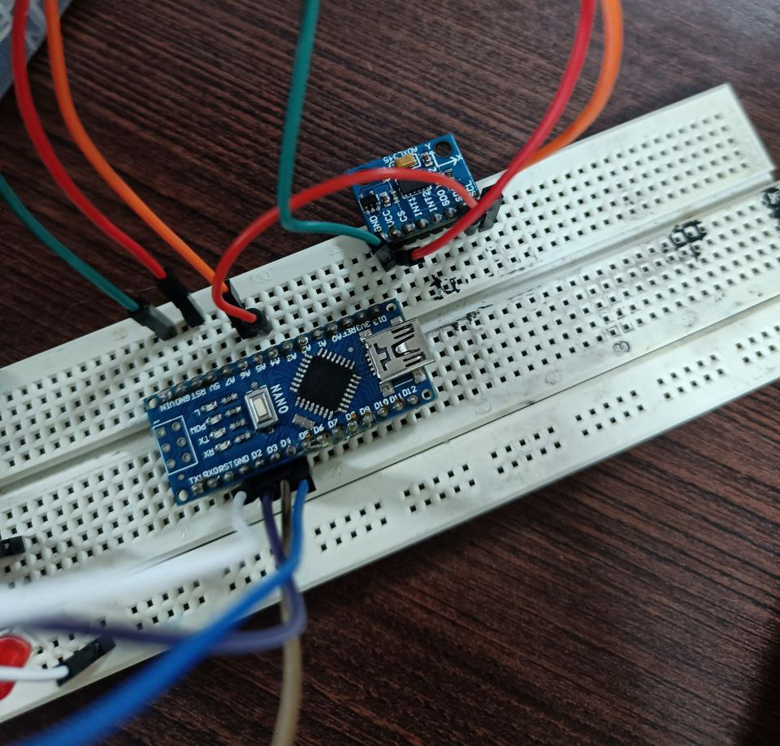

Slide 41
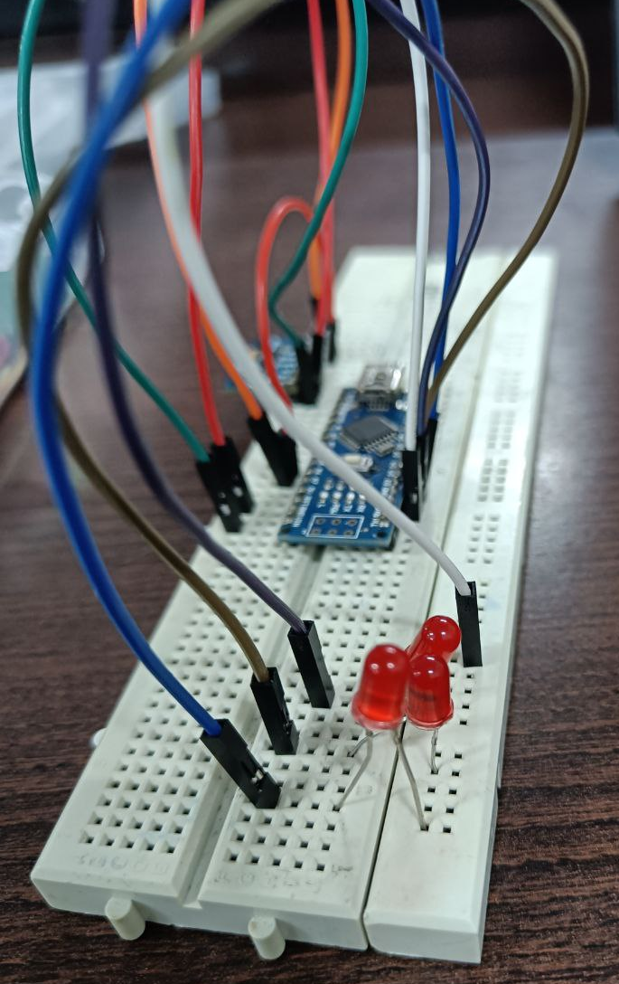

Slide 42
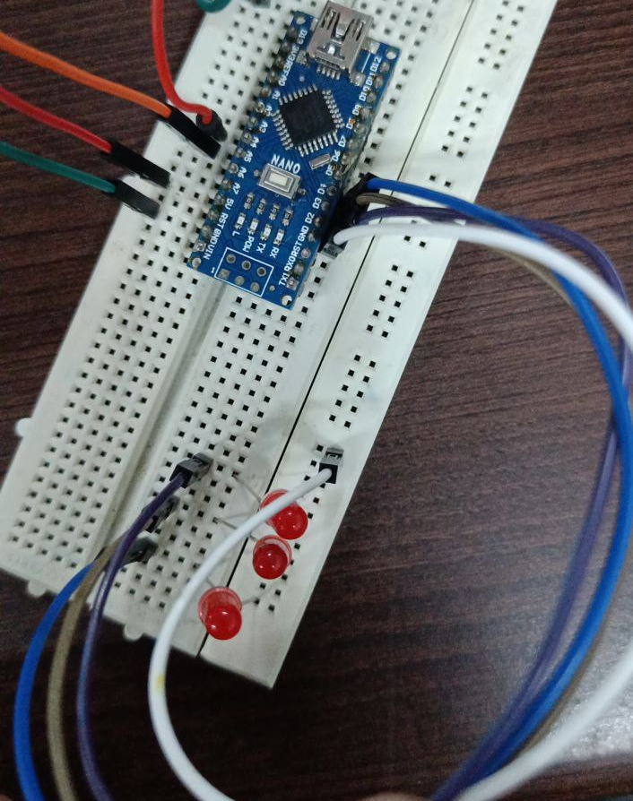

Slide 43
Hope you learnt something new

Slide 44
Ainesh and Parsh Signing off

